Slide 1
Principles of the Software Design
Course for Armenian-French University
Areg Melik-Adamyan
Petr Kurapov

Slide 2
Lecture 7
From algorithms to systems – Google's search engine architecture

Slide 3
Agenda
Algorithm is not enough
Levels of the mapping function to form
Difference between theoretical algorithm and algorithm at scale

Slide 4

Web as a Graph
Web as a directed graph:
Nodes: Webpages
Edges: Hyperlinks
CS246: Mining Massive Datasets
MSCI 541 Search Engines UWaterloo
I teach a class on Networks.
CS224W: Classes are in the Gates building
Computer Science Department at Stanford
Stanford University

Slide 5
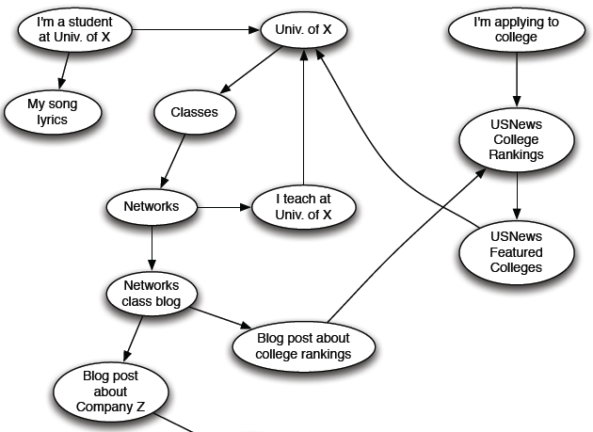
Web as a Directed Graph

Slide 6

Broad Question
How to organize the Web?
First try: Human curated Web directories
Yahoo, DMOZ, LookSmart
Second try: Web Search
Information Retrieval investigates: Find relevant docs in a small and trusted set
Newspaper articles, Patents, etc.
But: Web is huge, full of untrusted documents, random things, web spam, etc.

Slide 7
Web Search: 2 Challenges
2 challenges of web search:
(1) Web contains many sources of information Who to “trust”?
Trick: Trustworthy pages may point to each other!
(2) What is the “best” answer to query “newspaper”?
No single right answer
Trick: Pages that actually know about newspapers might all be pointing to many newspapers

Slide 8
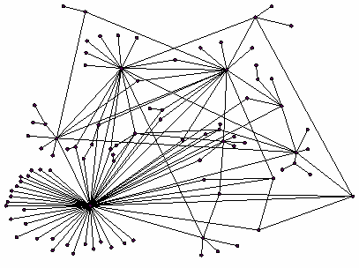
Ranking Nodes on the Graph
All web pages are not equally “important”
www.joe-schmoe.com vs. www.stanford.edu
There is large diversity in the web-graph node connectivity. Let’s rank the pages by the link structure!

Slide 9
Link Analysis Algorithms
We will cover the following Link Analysis approaches for computing importances of nodes in a graph:
Page Rank
Topic-Specific (Personalized) Page Rank
Web Spam Detection Algorithms

Slide 10
PageRank: The “Flow” Formulation

Slide 11
Links as Votes
Idea: Links as votes
Page is more important if it has more links
In-coming links? Out-going links?
Think of in-links as votes:
www.stanford.edu has 23,400 in-links
www.joe-schmoe.com has 1 in-link
Are all in-links are equal?
Links from important pages count more
Recursive question!

Slide 12
Example: PageRank Scores
B
38.4
C
34.3
A
3.3
D
3.9
E
8.1
F
3.9
1.6
1.6
1.6
1.6
1.6

Slide 13
Simple Recursive Formulation
Each link’s vote is proportional to the importance of its source page
If page j with importance r_{j} has n out-links, each link gets r_{j} / n votes
Page j’s own importance is the sum of the votes on its in-links
i
k
r_{i}/3
r_{k}/4
j
r_{j}/3
r_{j} = r_{i}/3+r_{k}/4
r_{j}/3
r_{j}/3

Slide 14

PageRank: The “Flow” Model
A “vote” from an important page is worth more
A page is important if it is pointed to by other important pages
Define a “rank” r_{j} for page j
The web in 1839
y/2
y
a/2
y/2
m
a
m
a/2
“Flow” equations:
r_{y} = r_{y} /2 + r_{a} /2
r_{a} = r_{y} /2 + r_{m}
r_{m} = r_{a} /2
$d_{i}$ … out-degree of node $i$

Slide 15
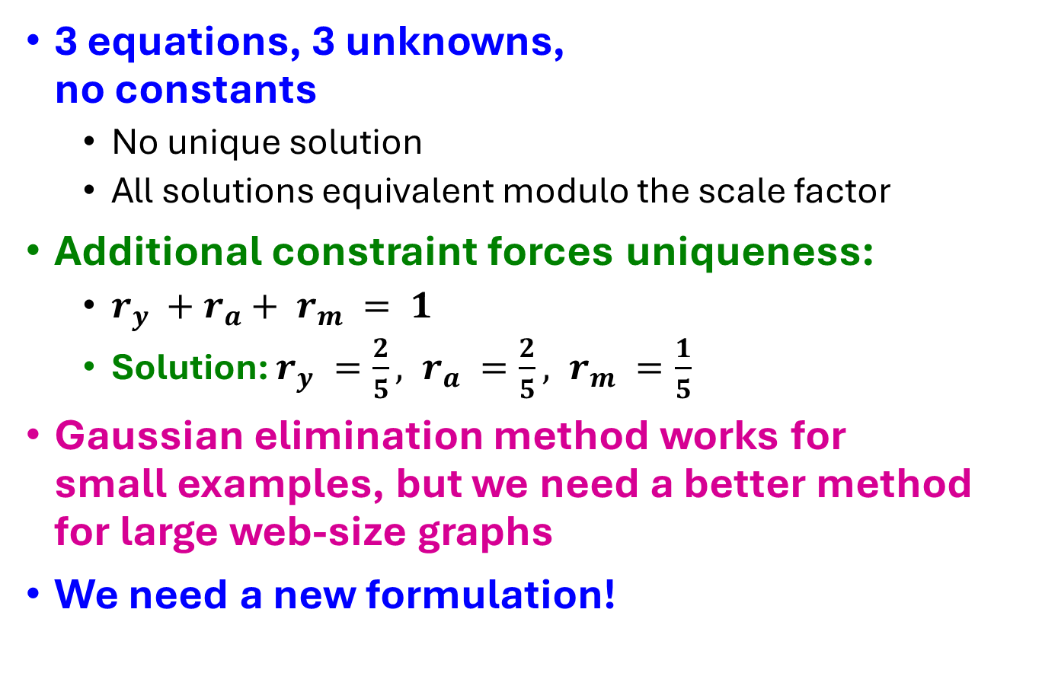
Solving the Flow Equations
Flow equations:
3 equations, 3 unknowns, no constants
No unique solution
All solutions equivalent modulo the scale factor
Additional constraint forces uniqueness:
$r_{y} +r_{a}+ r_{m} = 1$
Solution: $r_{y} =\frac{2}{5}, r_{a} =\frac{2}{5}, r_{m} =\frac{1}{5}$
Gaussian elimination method works for small examples, but we need a better method for large web-size graphs
We need a new formulation!
r_{y} = r_{y} /2 + r_{a} /2
r_{a} = r_{y} /2 + r_{m}
r_{m} = r_{a} /2

Slide 16
PageRank: Matrix Formulation
Stochastic adjacency matrix $M$
Let page $i$ has $di$ out-links
If $i →j$, then $Mji =\frac{1}{di}$ else $Mji = 0$
$M$ is a column stochastic matrix
Columns sum to 1
Rank vector $r$: vector with an entry per page
$ri$ is the importance score of page $i$
$\sum_{i}{r_{i}^{}=1}$
The flow equations can be written $r = M⋅ r$

Slide 17
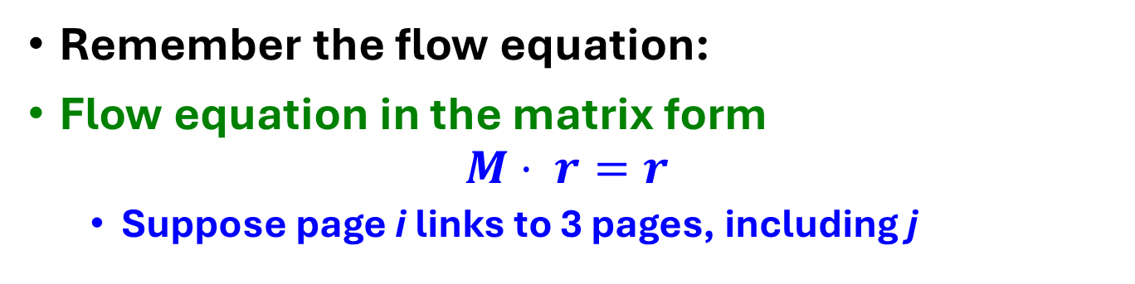
Example
Remember the flow equation:
Flow equation in the matrix form
$$M⋅ r=r$$
Suppose page i links to 3 pages, including j
i
j
r_{j}
.
=
r_{i}
1/3
M
.
r
=
r

Slide 18
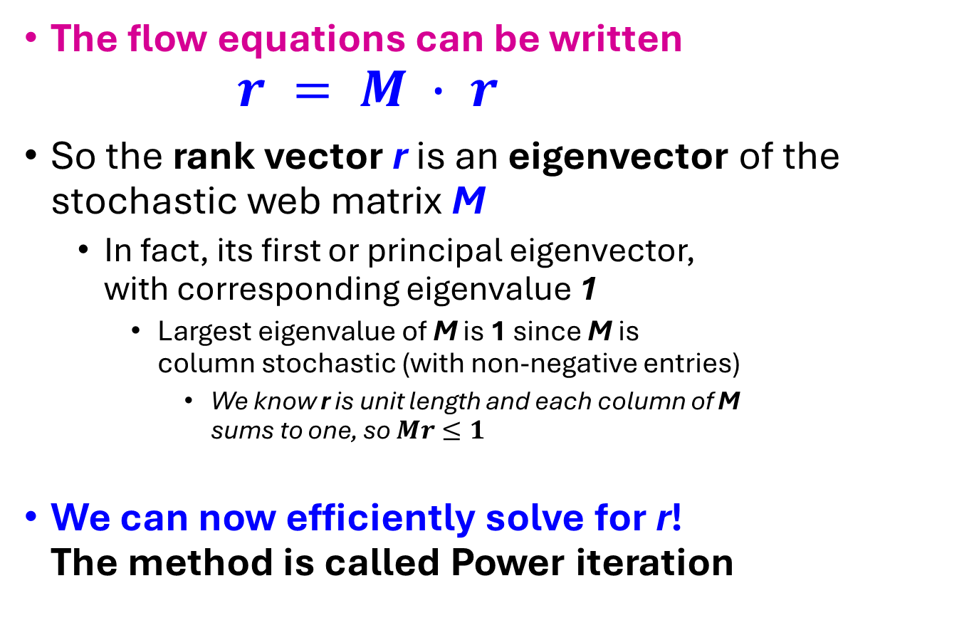

Eigenvector Formulation
The flow equations can be written $r = M ∙ r$
So the rank vector r is an eigenvector of the stochastic web matrix M
In fact, its first or principal eigenvector, with corresponding eigenvalue 1
Largest eigenvalue of M is 1 since M is column stochastic (with non-negative entries)
We know r is unit length and each column of M sums to one, so $Mr≤1$
We can now efficiently solve for r! The method is called Power iteration
NOTE: x is an eigenvector with the corresponding eigenvalue λ if: $$Ax=λx$$

Slide 19
Example: Flow Equations & M
 | y | a | m
y | ½ | ½ | 0
a | ½ | 0 | 1
m | 0 | ½ | 0
y
a
m
r = M∙r
r_{y} = r_{y} /2 + r_{a} /2
r_{a} = r_{y} /2 + r_{m}
r_{m} = r_{a} /2
y ½ ½ 0 y
a = ½ 0 1 a
m 0 ½ 0 m

Slide 20
Power Iteration Method
Given a web graph with n nodes, where the nodes are pages and edges are hyperlinks
Power iteration: a simple iterative scheme
Suppose there are N web pages
Initialize: r⁽⁰⁾ = [1/N,….,1/N]^{T}
Iterate: r^{(t+1)} = M ∙ r^{(t)}
Stop when |r^{(t+1)} – r^{(t)}|₁ < ε
d_{i} …. out-degree of node i
|x|₁ = ∑_{1≤i≤N}|x_{i}| is the L1 norm
Can use any other vector norm, e.g., Euclidean

Slide 21
PageRank: How to solve?
y
 | y | a | m
y | ½ | ½ | 0
a | ½ | 0 | 1
m | 0 | ½ | 0
Power Iteration:
Set $r_{j}=1$/N
1: ${r′}_{j}=\sum_{i→j}{\frac{r_{i}}{d_{i}}}$
2:$r=r′$
Goto 1
Example:
r_{y} 1/3 1/3 5/12 9/24 6/15
r_{a} = 1/3 3/6 1/3 11/24 … 6/15
r_{m} 1/3 1/6 3/12 1/6 3/15
a
m
r_{y} = r_{y} /2 + r_{a} /2
r_{a} = r_{y} /2 + r_{m}
r_{m} = r_{a} /2
Iteration 0, 1, 2, …

Slide 22
PageRank: How to solve?
y
 | y | a | m
y | ½ | ½ | 0
a | ½ | 0 | 1
m | 0 | ½ | 0
Power Iteration:
Set $r_{j}=1$/N
1: ${r′}_{j}=\sum_{i→j}{\frac{r_{i}}{d_{i}}}$
2:$r=r′$
Goto 1
Example:
r_{y} 1/3 1/3 5/12 9/24 6/15
r_{a} = 1/3 3/6 1/3 11/24 … 6/15
r_{m} 1/3 1/6 3/12 1/6 3/15
a
m
r_{y} = r_{y} /2 + r_{a} /2
r_{a} = r_{y} /2 + r_{m}
r_{m} = r_{a} /2
Iteration 0, 1, 2, …

Slide 23
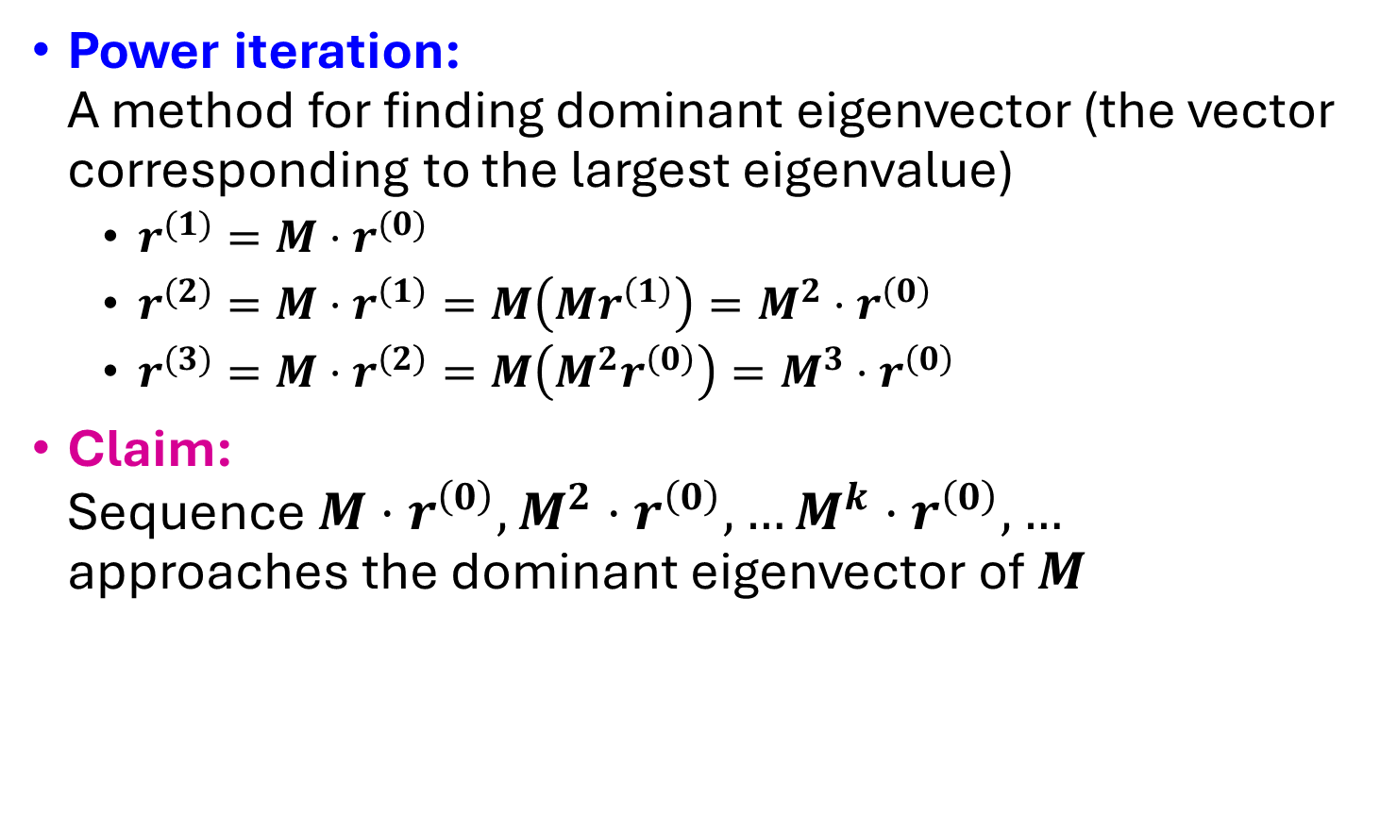
Why Power Iteration works? (1)
Details!
Power iteration: A method for finding dominant eigenvector (the vector corresponding to the largest eigenvalue)
$r^{(1)}=M⋅r^{(0)}$
$r^{(2)}=M⋅r^{\left(1\right)}=M\left(Mr^{\left(1\right)}\right)=M^{2}⋅r^{\left(0\right)}$
$r^{(3)}=M⋅r^{\left(2\right)}=M\left(M^{2}r^{\left(0\right)}\right)=M^{3}⋅r^{\left(0\right)}$
Claim: Sequence $M⋅r^{\left(0\right)},M^{2}⋅r^{\left(0\right)},…M^{k}⋅r^{\left(0\right)},…$ approaches the dominant eigenvector of $M$

Slide 24
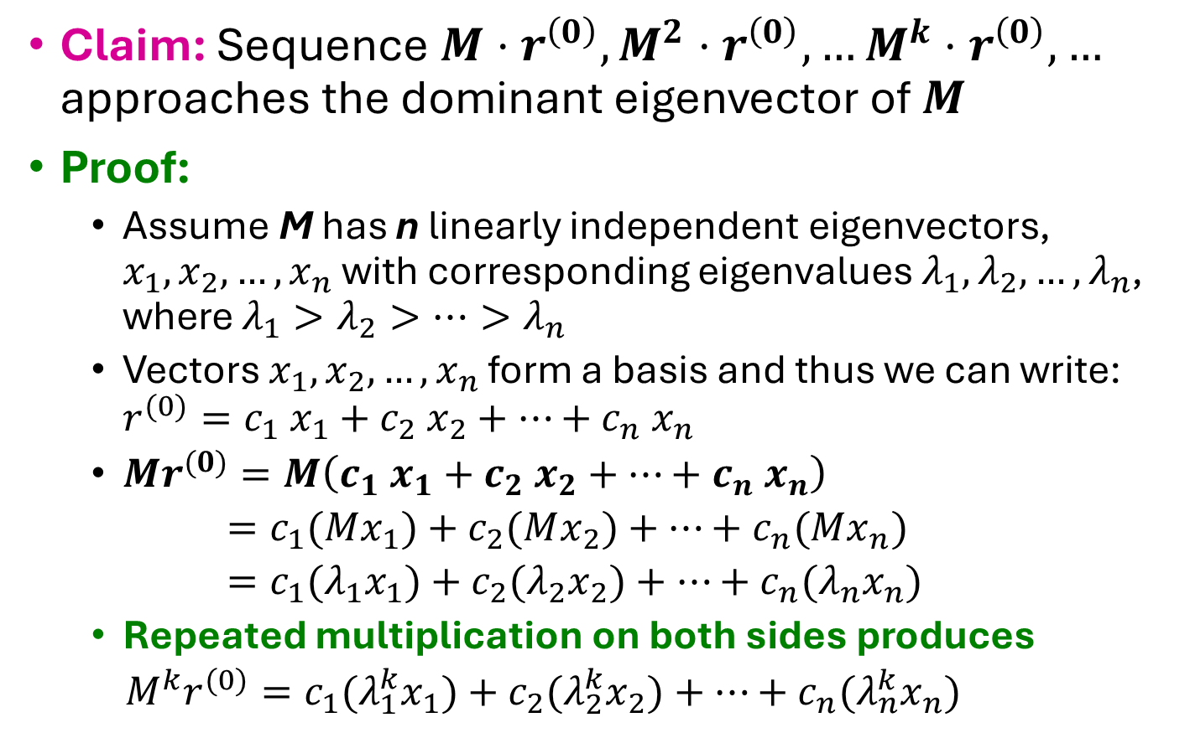
Why Power Iteration works? (2)
Details!
Claim: Sequence $M⋅r^{\left(0\right)},M^{2}⋅r^{\left(0\right)},…M^{k}⋅r^{\left(0\right)},…$ approaches the dominant eigenvector of $M$
Proof:
Assume M has n linearly independent eigenvectors, $x_{1}, x_{2}, …, x_{n}$ with corresponding eigenvalues $λ_{1},λ_{2}, …,λ_{n}$, where $λ_{1}>λ_{2}>…>λ_{n}$
Vectors $x_{1}, x_{2}, …, x_{n}$ form a basis and thus we can write: ${r^{(0)}=c_{1} x}_{1}+c_{2} x_{2}+…+c_{n} x_{n}$
$Mr^{(0)}=M\left(c_{1} x_{1}+c_{2} x_{2}+…+c_{n} x_{n}\right)$
$=c_{1}(Mx_{1})+c_{2}(Mx_{2})+…+c_{n}(Mx_{n})$
$=c_{1}(λ_{1}x_{1})+c_{2}(λ_{2}x_{2})+…+c_{n}(λ_{n}x_{n})$
Repeated multiplication on both sides produces
$M^{k}r^{(0)}=c_{1}(λ_{1}^{k}x_{1})+c_{2}(λ_{2}^{k}x_{2})+…+c_{n}(λ_{n}^{k}x_{n})$

Slide 25
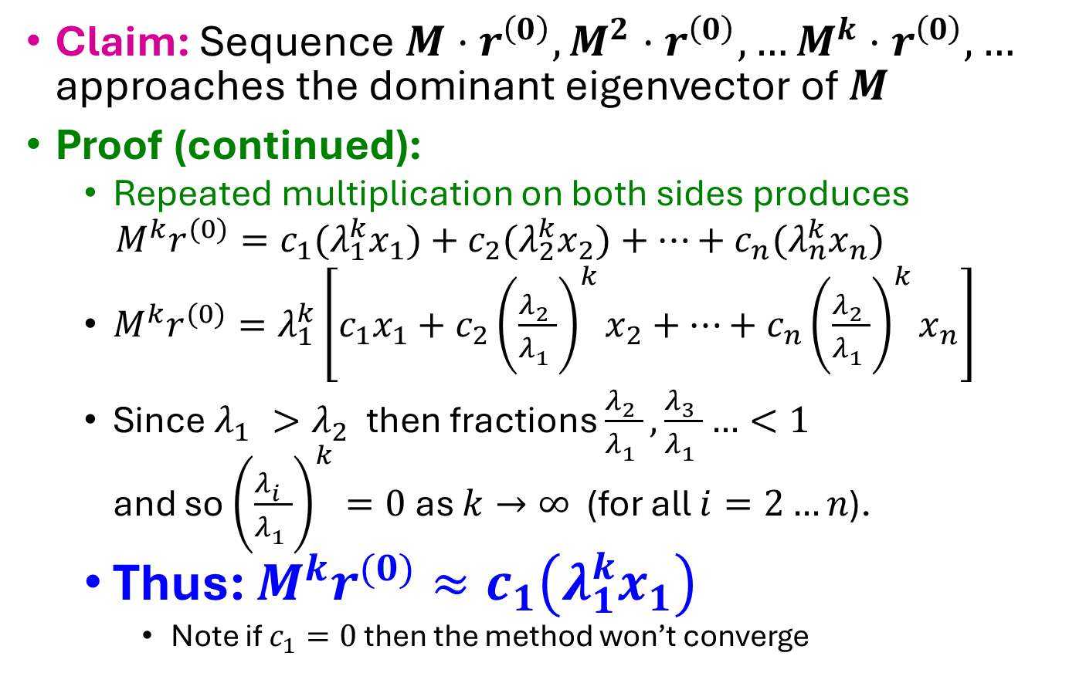
Why Power Iteration works? (3)
Details!
Claim: Sequence $M⋅r^{\left(0\right)},M^{2}⋅r^{\left(0\right)},…M^{k}⋅r^{\left(0\right)},…$ approaches the dominant eigenvector of $M$
Proof (continued):
Repeated multiplication on both sides produces
$M^{k}r^{(0)}=c_{1}(λ_{1}^{k}x_{1})+c_{2}(λ_{2}^{k}x_{2})+…+c_{n}(λ_{n}^{k}x_{n})$
$M^{k}r^{(0)}=λ_{1}^{k}\left[c_{1}x_{1}+c_{2}{\left(\frac{λ_{2}^{}}{λ_{1}^{}}\right)}^{k}x_{2}+…+c_{n}{\left(\frac{λ_{2}^{}}{λ_{1}^{}}\right)}^{k}x_{n}\right]$
Since $λ_{1}^{}>λ_{2}^{}$ then fractions $\frac{λ_{2}^{}}{λ_{1}^{}},\frac{λ_{3}^{}}{λ_{1}^{}}…<1$ and so ${\left(\frac{λ_{i}^{}}{λ_{1}^{}}\right)}^{k}=0$ as $k→∞$ (for all $i=2…n$).
Thus: $M^{k}r^{(0)}≈c_{1}\left(λ_{1}^{k}x_{1}\right)$
Note if $c_{1}=0$ then the method won’t converge

Slide 26
Random Walk Interpretation
i₁
i₂
i₃
Imagine a random web surfer:
At any time $t$, surfer is on some page $i$
At time $t+1$, the surfer follows an out-link from $i$ uniformly at random
Ends up on some page $j$ linked from $i$
Process repeats indefinitely
Let:
$p(t)$ … vector whose $i$^{th} coordinate is the prob. that the surfer is at page $i$ at time $t$
So, $p(t)$ is a probability distribution over pages
j

Slide 27
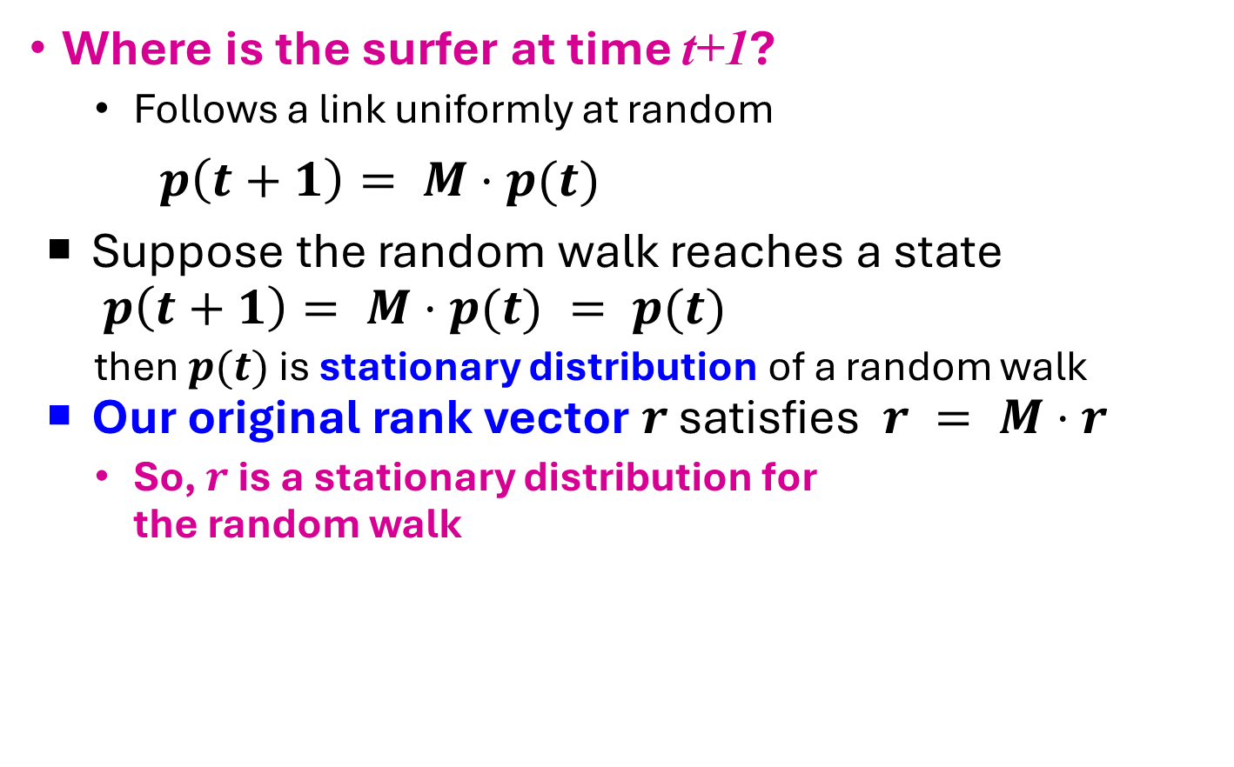
The Stationary Distribution
i₁
i₂
i₃
Where is the surfer at time t+1?
Follows a link uniformly at random
$p\left(t+1\right)= M⋅p(t)$
Suppose the random walk reaches a state $p\left(t+1\right)= M⋅p(t) = p(t)$
then $p(t)$ is stationary distribution of a random walk
Our original rank vector $r$ satisfies $r = M⋅r$
So, $r$ is a stationary distribution for the random walk
j

Slide 28
Existence and Uniqueness
A central result from the theory of random walks (a.k.a. Markov processes):
For graphs that satisfy certain conditions, the stationary distribution is unique and eventually will be reached no matter what the initial probability distribution at time t = 0

Slide 29
PageRank: The Google Formulation

Slide 30
PageRank: Three Questions
Does this converge?
Does it converge to what we want?
Are results reasonable?
or
equivalently

Slide 31
Does this converge?
Example:
r_{a} 1 0 1 0
r_{b} 0 1 0 1
a
b
=
Iteration 0, 1, 2, …

Slide 32
Does it converge to what we want?
Example:
r_{a} 1 0 0 0
r_{b} 0 1 0 0
a
b
=
Iteration 0, 1, 2, …

Slide 33
PageRank: Problems
Dead end
2 problems:
(1) Some pages are dead ends (have no out-links)
Random walk has “nowhere” to go to
Such pages cause importance to “leak out”
(2) Spider traps: (all out-links are within the group)
Random walked gets “stuck” in a trap
And eventually spider traps absorb all importance
Spider trap

Slide 34
Problem: Spider Traps
y
 | y | a | m
y | ½ | ½ | 0
a | ½ | 0 | 0
m | 0 | ½ | 1
Power Iteration:
Set $r_{j}=1$
$r_{j}=\sum_{i→j}{\frac{r_{i}}{d_{i}}}$
And iterate
Example:
r_{y} 1/3 2/6 3/12 5/24 0
r_{a} = 1/3 1/6 2/12 3/24 … 0
r_{m} 1/3 3/6 7/12 16/24 1
a
m
m is a spider trap
r_{y} = r_{y} /2 + r_{a} /2
r_{a} = r_{y} /2
r_{m} = r_{a} /2 + r_{m}
Iteration 0, 1, 2, …
All the PageRank score gets “trapped” in node m.

Slide 35
Solution: Teleports!
The Google solution for spider traps: At each time step, the random surfer has two options
With prob. β, follow a link at random
With prob. 1-β, jump to some random page
Common values for β are in the range 0.8 to 0.9
Surfer will teleport out of spider trap within a few time steps
y
y
a
m
a
m

Slide 36
Problem: Dead Ends
y
 | y | a | m
y | ½ | ½ | 0
a | ½ | 0 | 0
m | 0 | ½ | 0
Power Iteration:
Set $r_{j}=1$
$r_{j}=\sum_{i→j}{\frac{r_{i}}{d_{i}}}$
And iterate
Example:
r_{y} 1/3 2/6 3/12 5/24 0
r_{a} = 1/3 1/6 2/12 3/24 … 0
r_{m} 1/3 1/6 1/12 2/24 0
a
m
r_{y} = r_{y} /2 + r_{a} /2
r_{a} = r_{y} /2
r_{m} = r_{a} /2
Iteration 0, 1, 2, …
Here the PageRank “leaks” out since the matrix is not stochastic.

Slide 37
Solution: Always Teleport!
Teleports: Follow random teleport links with probability 1.0 from dead-ends
Adjust matrix accordingly
y
y
a
m
a
m
 | y | a | m
y | ½ | ½ | 0
a | ½ | 0 | 0
m | 0 | ½ | 0
 | y | a | m
y | ½ | ½ | ⅓
a | ½ | 0 | ⅓
m | 0 | ½ | ⅓

Slide 38
Why Teleports Solve the Problem?
Why are dead-ends and spider traps a problem and why do teleports solve the problem?
Spider-traps are not a problem, but with traps PageRank scores are not what we want
Solution: Never get stuck in a spider trap by teleporting out of it in a finite number of steps
Dead-ends are a problem
The matrix is not column stochastic so our initial assumptions are not met
Solution: Make matrix column stochastic by always teleporting when there is nowhere else to go

Slide 39
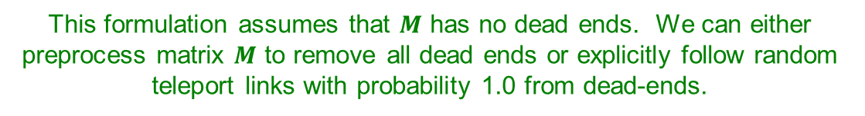
Solution: Random Teleports
Google’s solution that does it all: At each step, random surfer has two options:
With probability β, follow a link at random
With probability 1-β, jump to some random page
PageRank equation [Brin-Page, 98] $r_{j}=\sum_{i→j}{β \frac{r_{i}}{d_{i}}}+(1−β)\frac{1}{N}$
d_{i} … out-degree of node i
This formulation assumes that $M$ has no dead ends. We can either preprocess matrix $M$ to remove all dead ends or explicitly follow random teleport links with probability 1.0 from dead-ends.

Slide 40
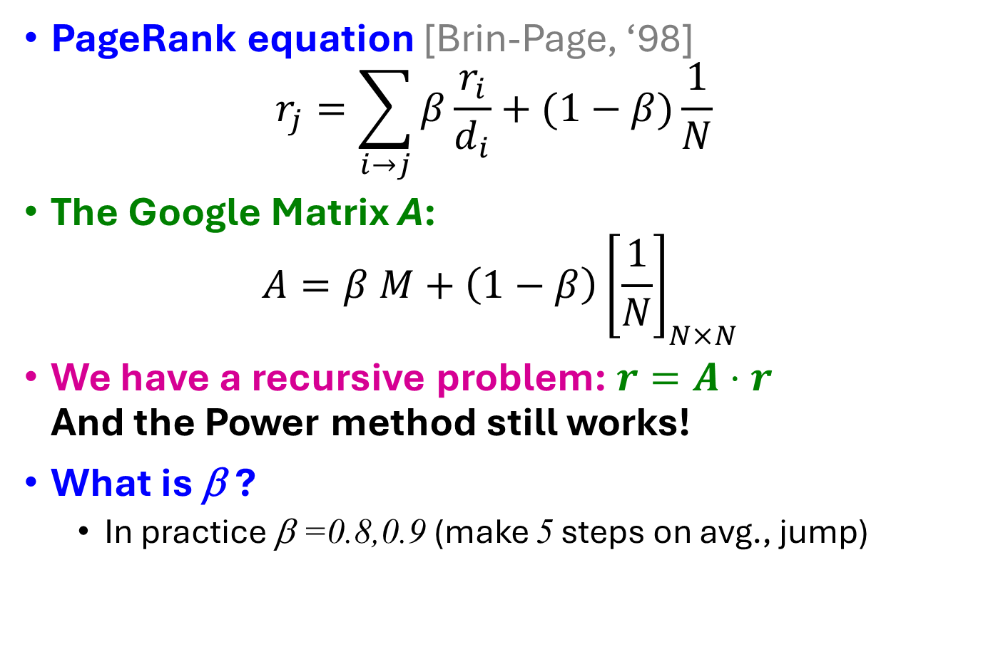
The Google Matrix
PageRank equation [Brin-Page, ‘98] $r_{j}=\sum_{i→j}{β\frac{r_{i}}{d_{i}}}+(1−β)\frac{1}{N}$
The Google Matrix A:
$$A=β M+\left(1−β\right){\left[\frac{1}{N}\right]}_{N×N}$$
We have a recursive problem: $r=A⋅r$ And the Power method still works!
What is β ?
In practice β =0.8,0.9 (make 5 steps on avg., jump)
[1/N]_{NxN}…N by N matrix where all entries are 1/N

Slide 41
Random Teleports (β = 0.8)
M
[1/N]_{NxN}
7/15
y
1/2 1/2 0
1/2 0 0
0 1/2 1
1/3 1/3 1/3
1/3 1/3 1/3
1/3 1/3 1/3
0.8
+ 0.2
7/15
1/15
7/15
1/15
y 7/15 7/15 1/15
a 7/15 1/15 1/15
m 1/15 7/15 13/15
13/15
a
7/15
m
1/15
1/15
A
y
a =
m
1/3
1/3
1/3
0.33
0.20
0.46
0.24
0.20
0.52
0.26
0.18
0.56
7/33
5/33
21/33
. . .

Slide 42
How do we actually compute the PageRank?

Slide 43
Computing Page Rank
Key step is matrix-vector multiplication
r^{new} = A ∙ r^{old}
Easy if we have enough main memory to hold A, r^{old}, r^{new}
Say N = 1 billion pages
We need 4 bytes for each entry (say)
2 billion entries for vectors, approx 8GB
Matrix A has N² entries
10¹⁸ is a large number!
A = β∙M + (1-β) [1/N]_{NxN}
½ ½ 0
½ 0 0
0 ½ 1
1/3 1/3 1/3
1/3 1/3 1/3
1/3 1/3 1/3
A =
0.8
+0.2
7/15 7/15 1/15
7/15 1/15 1/15
1/15 7/15 13/15
=

Slide 44
Matrix Formulation
Suppose there are N pages
Consider page i, with d_{i} out-links
We have M_{ji} = 1/|d_{i}| when i → j and M_{ji} = 0 otherwise
The random teleport is equivalent to:
Adding a teleport link from i to every other page and setting transition probability to (1-β)/N
Reducing the probability of following each out-link from 1/|d_{i}| to β/|d_{i}|
Equivalent: Tax each page a fraction (1-β) of its score and redistribute evenly

Slide 45
Rearranging the Equation
$r =A⋅r$, where $A_{ji}=β{ M}_{ji}+\frac{1−β}{N}$
$r_{j} =\sum_{i=1}^{N}{A_{ji}⋅r_{i}}$
$r_{j} =\sum_{i=1}^{N}{\left[β{ M}_{ji}+\frac{1−β}{N}\right]⋅r_{i}}$
$=\sum_{i=1}^{N}{β{ M}_{ji}⋅r_{i}+\frac{1−β}{N}}\sum_{i=1}^{N}{r_{i}}$
$=\sum_{i=1}^{N}{β{ M}_{ji}⋅r_{i}+\frac{1−β}{N}}$ since $∑r_{i}=1$
So we get: $r=β M⋅r+{\left[\frac{1−β}{N}\right]}_{N}$
Note: Here we assumed M has no dead-ends
[x]_{N} … a vector of length N with all entries x

Slide 46
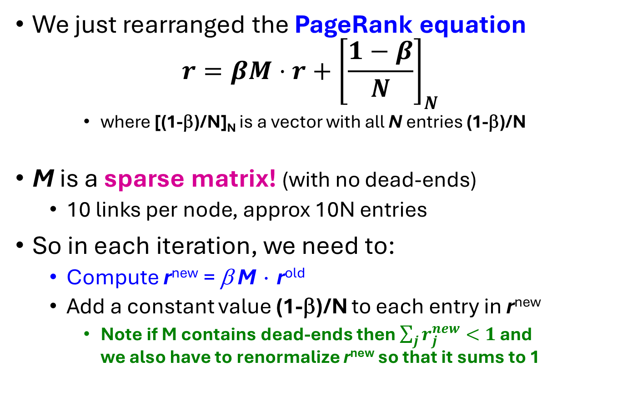
Sparse Matrix Formulation
We just rearranged the PageRank equation
$$r=βM⋅r+{\left[\frac{1−β}{N}\right]}_{N}$$
where [(1-β)/N]_{N} is a vector with all N entries (1-β)/N
M is a sparse matrix! (with no dead-ends)
10 links per node, approx 10N entries
So in each iteration, we need to:
Compute r^{new} = β M ∙ r^{old}
Add a constant value (1-β)/N to each entry in r^{new}
Note if M contains dead-ends then $\sum_{j}{r_{j}^{new}}<1$ and we also have to renormalize r^{new} so that it sums to 1

Slide 47
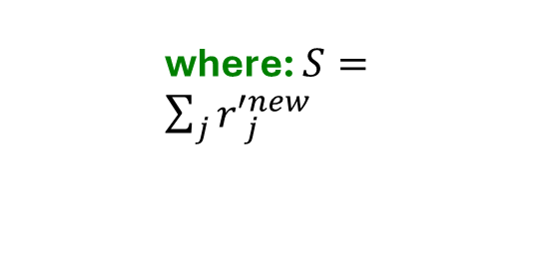

PageRank: The Complete Algorithm
Input: Graph $G$ and parameter $β$
Directed graph $G$ (can have spider traps and dead ends)
Parameter $β$
Output: PageRank vector $r^{new}$
Set: $r_{j}^{old} =\frac{1}{N}$
repeat until convergence: $\sum_{j}{\left|r_{j}^{new}−r_{j}^{old}\right|>ε}$
$∀j: {r′}_{j}^{new}=\sum_{i→j}{β \frac{r_{i}^{old}}{d_{i}}}$
${r′}_{j}^{new}=0$ if in-degree of $j$ is 0
Now re-insert the leaked PageRank:
$∀j: r_{j}^{new}={r^{′}}_{j}^{new}+\frac{1−S}{N}$
$r^{old}=r^{new}$
where: $S=\sum_{j}{{r′}_{j}^{new}}$
If the graph has no dead-ends then the amount of leaked PageRank is 1-β. But since we have dead-ends the amount of leaked PageRank may be larger. We have to explicitly account for it by computing S.

Slide 48
Sparse Matrix Encoding
Encode sparse matrix using only nonzero entries
Space proportional roughly to number of links
Say 10N, or 4*10*1 billion = 40GB
Still won’t fit in memory, but will fit on disk
source
node
degree
destination nodes
0 | 3 | 1, 5, 7
1 | 5 | 17, 64, 113, 117, 245
2 | 2 | 13, 23

Slide 49
Basic Algorithm: Update Step
Assume enough RAM to fit r^{new} into memory
Store r^{old} and matrix M on disk
1 step of power-iteration is:
Initialize all entries of r^{new} = (1-β) / N
For each page i (of out-degree d_{i}):
Read into memory: i, d_{i}, dest₁, …, dest_{di}, r^{old}(i)
For j = 1…d_{i}
r^{new}(dest_{j}) += β r^{old}(i) / d_{i}
0
r^{new}
source
degree
destination
r^{old}
0
1
0 | 3 | 1, 5, 6
1 | 4 | 17, 64, 113, 117
2 | 2 | 13, 23
1
2
2
3
3
4
4
5
5
6
6
Notes:
Remember to say that we first initialize r^new to 1-beta/n

Slide 50
Analysis
Assume enough RAM to fit r^{new} into memory
Store r^{old} and matrix M on disk
In each iteration, we have to:
Read r^{old} and M
Write r^{new} back to disk
Cost per iteration of Power method: = 2|r| + |M|
Question:
What if we could not even fit r^{new} in memory?

Slide 51
Block-based Update Algorithm
r^{new}
src
degree
destination
r^{old}
0
0 | 4 | 0, 1, 3, 5
1 | 2 | 0, 5
2 | 2 | 3, 4
0
1
1
2
2
3
4
3
M
5
4
5
Break r^{new} into k blocks that fit in memory
Scan M and r^{old} once for each block

Slide 52
Analysis of Block Update
Similar to nested-loop join in databases
Break r^{new} into k blocks that fit in memory
Scan M and r^{old} once for each block
Total cost:
k scans of M and r^{old}
Cost per iteration of Power method: k(|M| + |r|) + |r| = k|M| + (k+1)|r|
Can we do better?
Hint: M is much bigger than r (approx 10-20x), so we must avoid reading it k times per iteration

Slide 53
Block-Stripe Update Algorithm
src
degree
destination
r^{new}
0 | 4 | 0, 1
1 | 3 | 0
2 | 2 | 1
0
1
r^{old}
0
1
2
2
0 | 4 | 3
2 | 2 | 3
3
4
3
5
0 | 4 | 5
1 | 3 | 5
2 | 2 | 4
4
5
Break M into stripes! Each stripe contains only destination nodes in the corresponding block of r^{new}

Slide 54
Block-Stripe Analysis
Break M into stripes
Each stripe contains only destination nodes in the corresponding block of r^{new}
Some additional overhead per stripe
But it is usually worth it
Cost per iteration of Power method: =|M|(1+ε) + (k+1)|r|

Slide 55
Some Problems with Page Rank
Measures generic popularity of a page
Biased against topic-specific authorities
Solution: Topic-Specific PageRank (next)
Uses a single measure of importance
Other models of importance
Solution: Hubs-and-Authorities
Susceptible to Link spam
Artificial link topographies created in order to boost page rank
Solution: TrustRank

Slide 56
The search system design problem
Web pages attempt to mislead automated search engines to gain people’s attention
People’s ability to look through search results does not scale – need very high precision – relevance.

Slide 57
Overall goals for search system
High Throughput & Low Latency: Serve billions of queries quickly, typically under a second.
Scalability: Handle billions of documents and links across many data centers.
Relevance & Quality: Use advanced ranking algorithms (including PageRank, machine learning models, user signals) to return high-quality results.
Fault Tolerance: Continue operating smoothly even if individual components fail.
Freshness: Keep the index up to date with frequent crawls and incremental updates.

Slide 58
Some Naïve implementation
def pagerank(links, alpha=0.85, max_iter=100, tol=1e-6): nodes = list(links.keys()) N = len(nodes) if N == 0: return {} pagerank_scores = {node: 1.0 / N for node in nodes} for _ in range(max_iter): new_scores = {node: (1 - alpha) / N for node in nodes} for node in nodes: out_links = links[node] if len(out_links) == 0: for n in nodes: new_scores[n] += alpha * (pagerank_scores[node] / N) else: rank_to_give = alpha * pagerank_scores[node] / len(out_links) for out_node in out_links: new_scores[out_node] += rank_to_give diff = sum(abs(new_scores[node] - pagerank_scores[node]) for node in nodes) pagerank_scores = new_scores if diff < tol: break return pagerank_scores

Slide 59
Design Considerations
What are the functional, performance and other requirements?
How to get pages?
How to parse them?
Where is the index?
How to store the index?
What the iteration should look like?
Etc…
Where are the volatility points?

Slide 60
Some structure
PageRank is a key component of a large-scale search system, but it's not the only one. Largely can be divided into offline and online pipelines.
Crawling: Web crawlers systematically explore the web, following links to discover new pages and build an index.
Indexing: The crawled pages are indexed, creating a database that maps keywords and other information to the URLs of relevant pages.
PageRank Calculation (Offline): The PageRank algorithm is run offline on the crawled web graph. This is a computationally intensive process, often done using distributed computing frameworks like MapReduce or Spark. The computed PageRank scores are stored in the index.
Query Processing: When a user enters a search query:
Retrieval: The search engine uses the index to retrieve a set of pages that are relevant to the query based on keyword matching, content analysis, and other factors.
Ranking: The retrieved pages are then ranked using a combination of factors, including:
PageRank: The pre-computed PageRank score is a strong signal of a page's importance.
Relevance: How well does the page's content match the query?
Other Factors: Search engines use many other ranking factors, such as content freshness, user location, user engagement metrics, and more. They keep their specific ranking algorithms highly confidential.
Presentation: The top-ranked results are displayed to the user.

Slide 61
Crawling - Offline pipeline
Seed URLs: The search engine begins with a set of initial web addresses (e.g., top sites or directories).
Crawler/Spider:
Automatically fetches webpages from the internet.
Extracts links (e.g., <a href="...">) from each page.
Adds newly discovered links to a queue for future crawling (subject to policies like robots.txt, politeness, domain constraints, etc.).
Frontier Management: A “frontier” or “crawl queue” holds URLs to visit next. Prioritization is often based on page importance, refresh schedules (for changing content), or historical signals.
Crawlers run continuously to discover new pages and check for content updates. They operate in a distributed fashion over many machines to handle billions of pages.

Slide 62
Document processing – Offline pipeline
Parsing and Cleaning:
Remove boilerplate HTML, ads, or scripts.
Extract the main text content and metadata (title, headers, meta tags, etc.).
Language Detection: Identify the page’s language for later indexing steps.
Tokenization: Convert text into a sequence of tokens (words, phrases).
Normalization:
Lowercasing, stemming/lemmatization (e.g., “cats” → “cat”).
Handling special characters, punctuation, etc.
Feature Extraction:
Collect additional signals: anchor text from inbound links, keywords from metadata, etc.
Possibly identify named entities (people, places, organizations).
Spam Detection: Filter out pages or devalue them if they exhibit spammy patterns.

Slide 63
Link Analysis - offline
Link Graph Construction: Use extracted links to build a directed graph of webpages.
Link-Based Scoring: Compute PageRank or other link-based metrics (e.g., HITS, TrustRank). These scores indicate “authority” or “importance.”
Store Scores: Once computed, these link-based signals (like PageRank) are saved in a lookup table keyed by document (or page) ID.

Slide 64
Index Building – Offline pipeline
Inverted Index Construction:
For each token (word), store a sorted list of documents where the token appears. This inverted list often includes position information and term-level statistics (frequency, offsets, etc.).
This process typically involves MapReduce (or a similar distributed framework) to shuffle and sort data at scale.
Forward Index / Document Storage:
Store each document’s metadata (title, snippet, URL, page length, language).
May also store a compressed version of the raw text to enable snippet generation during serving.
Merging & Optimizing:
Large indexes are often built in shards.
Periodically, partial indexes are merged into larger segments.
The final index is optimized for fast lookups (using compression, skip pointers, advanced data structures).

Slide 65
Updating – offline pipeline
Periodic Crawls: The system regularly fetches new or changed pages.
Delta Updates: Changes are fed into the index pipeline, producing updated shard segments.
Refresh Scores: Link-based scores (e.g., PageRank) can be recalculated periodically (daily, weekly, or monthly, depending on resources and freshness requirements).

Slide 66
Query Handling – online pipeline
Front-End (User Interface):
Receives user queries (e.g., via a web interface or API).
Sends query text to the search backend.
Query Parsing & Interpretation:
Tokenizes and normalizes the user query (similar to document processing).
May perform spelling correction, query expansion, or entity recognition.
Identifies languages, potential synonyms, or “did you mean” suggestions.
Distributed Query Routing:
The query is sent to query servers spread across multiple data centers.
For load balancing, the system may route queries to the nearest or least-busy data center.

Slide 67
Retreival from index
Shard Lookup:
The huge index is typically split into multiple shards (vertical partition) and replicas (for redundancy and parallelism).
Each shard contains a portion of the web documents.
Inverted Index Search:
For each query token, the engine looks up the corresponding postings lists (document lists).
A candidate set of documents that contain the query terms is formed.
Scoring & Ranking:
Each shard calculates a preliminary relevance score for each candidate document using:
Textual relevance: e.g., BM25, vector space models, or neural IR signals.
Link-based signals: PageRank, inlinks, anchor text relevance.
Other signals: Document freshness, user behavior data (click-through rates), or machine-learned ranking features.
A partial ranked list is returned to a central aggregator (if needed).
Aggregation:
The partial results from each shard are merged.
The top kkk results (e.g., top 1000 across all shards) are consolidated and sorted again globally.

Slide 68
Final Reranking
Advanced Ranking:
A machine-learned ranking model may do a final pass on the top documents.
Additional signals (personalization, user context, location) can be applied here.
Snippet Generation:
A short preview or snippet is generated by extracting relevant terms from the document text.
Bold or highlight query keywords.
UI Rendering:
The final top search results are sent back to the front-end.
The user sees a list of titles, snippets, URLs, etc.

Slide 69
Google architecture overview
Store server
Crawler
URL server
Crawler
Crawler
Repository
Indexer
Anchors
URL resolver
Lexicon
Barrels
Links
Doc index
Sorter
Sorter
Sorter
PageRank
Searcher
Notes:
URL server sends lists of URLs to crawlers
Web crawling by distributed crawlers
Fetched pages sent to store server – compression & store to repo by docID
Indexing by indexer and sorter
Indexer reads pages from repo and parses them – docs converted to set of word occurrences – “hits” (word, position in doc, font, size, capitalization)
Hits are distributed into barrels – partially sorted forward index
Indexer parses and stores links into an anchor file (from, to, text of the link)
URL resolver reads anchors, converts relative urls to absolute into docID; put text into forward index
Resolver generates links – pairs of docIDs
Pagerank computes ranking from the links db
Sorter creates inverted index (from docID to wordID)
Dumplexicon util takes inverted index and lexicon from indexer and produces new lexicon for the searcher
Searcher is run be a web server and uses the lexicon, inverted index and pageranks to answer queries

Slide 70
Overall Flow
Offline Pipeline continuously gathers and processes new/updated web content:
Web crawler fetches pages → Document parsing & cleaning → Index building → Link analysis → Merged indexes stored in distributed shards.
Online Pipeline handles user queries:
Query parsing → Shard lookups → Ranking & scoring → Results aggregation → Final rerank → Snippet generation → Present results to user.

Slide 71
Backup

Slide 72
Web structure
Page relevance is subjective, however there are objective methods to estimate human interest.
Ranking quality for each web page is calculated using the link structure of the Web.
Forward links (outedges) and backlinks (inedges) – B, C, D are backlinks of A.
Highly linked pages are likely more “important”.
A
B
C
D
Notes:
All forward links are known if a page is downloaded
We can never know all the backlinks

Slide 73

PageRank
“A page has high rank if the sum of the ranks of its backlinks is high”.
$$R\left(u\right)=c\sum_{v∈B_{u}}{\frac{R(v)}{\left|F_{v}\right|}}$$
Backlinks(U)
U
Forwardlinks(U)
Notes:
C – normalization factor (<1 since there are pages with no forward links)

Slide 74
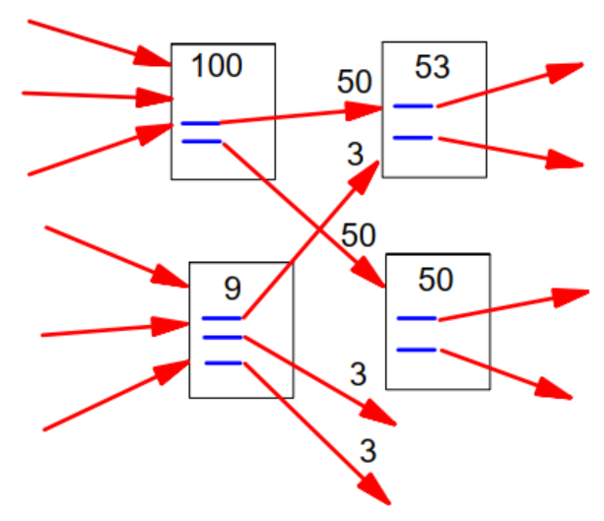
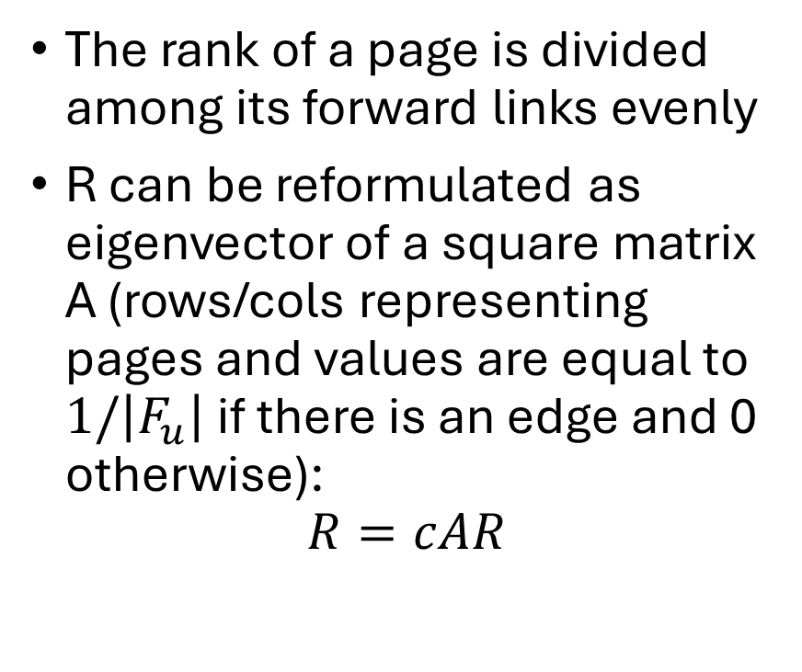
PageRank
The rank of a page is divided among its forward links evenly
R can be reformulated as eigenvector of a square matrix A (rows/cols representing pages and values are equal to $1/\left|F_{u}\right|$ if there is an edge and 0 otherwise):
$$R=cAR$$
Notes:
R – eigenvector with eigenvalue “c”, meaning R can be computed by iteratively applying A to any nondegenerate start vector

Slide 75
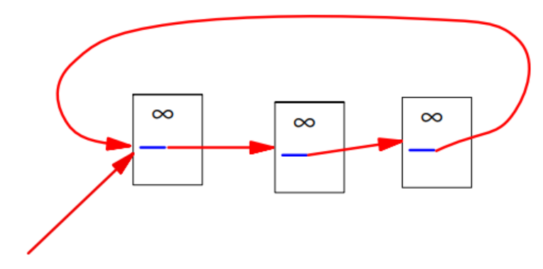
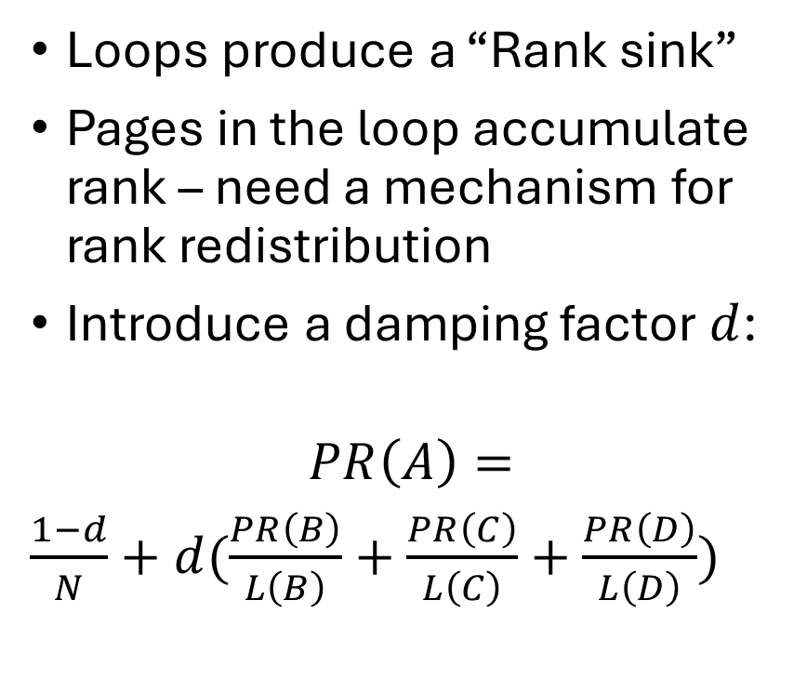
PageRank
Loops produce a “Rank sink”
Pages in the loop accumulate rank – need a mechanism for rank redistribution
Introduce a damping factor $d$:
$$PR\left(A\right)=$$
$\frac{1−d}{N}+d(\frac{PR\left(B\right)}{L\left(B\right)}+\frac{PR\left(C\right)}{L\left(C\right)}+\frac{PR\left(D\right)}{L\left(D\right)})$
A
B
C
D
Notes:
Pageranks form a probability distribution over web pages – sum of all is 1.
Markov chain – random surfer & empirical d = 0.85 – probability of a random surfer to get bored.

